Slide 1
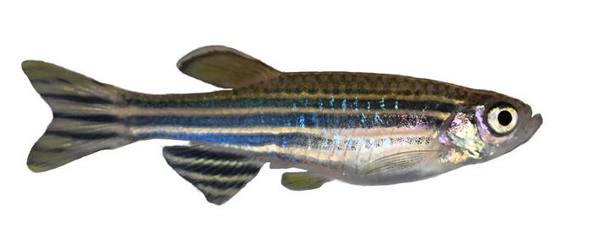
Case Study 5: Screening of antimicrobial drugs using zebrafish embryos
AD22HS24, MoIm
Kai Aebli, David Senn

Slide 2
The victim
70% homology with the human genome
Cost-effective
Suitable for genetic modification
Transparent embryos
Why me?

Slide 3
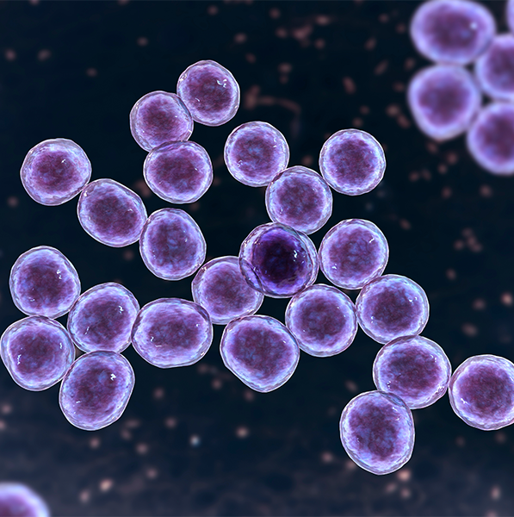
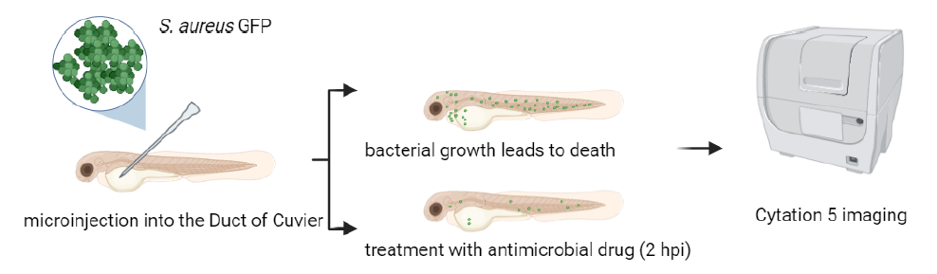
The experiment
48h post-fertilization:
Zebrafish embryos are injected with GFP-expressing staphylococcus aureus
2h post-injection:
Injection with antimicrobial drug – Vancomycin, MEndoB
Imaging over time
every 15 min, for 60 time-points (total 15h, 2562 images)
Task:
Quantify the GFP-Signal over time

Slide 4
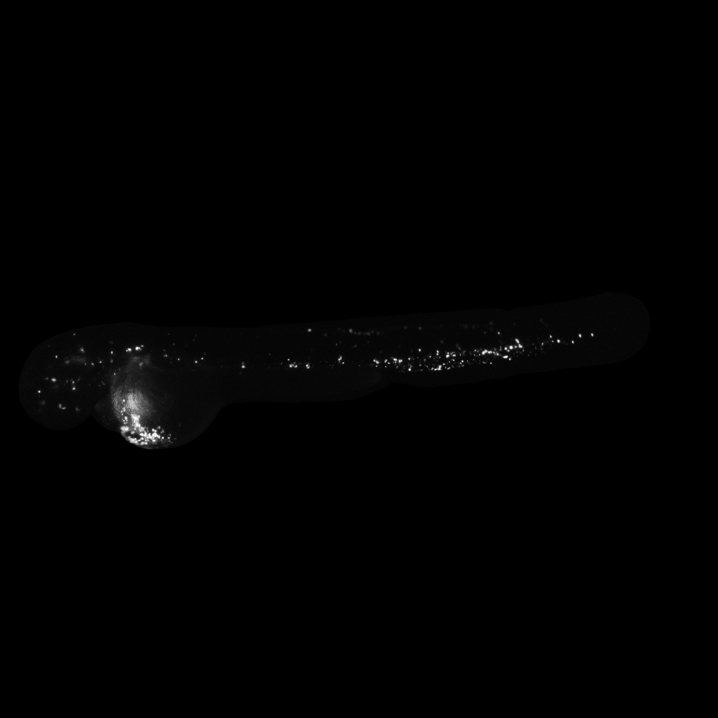
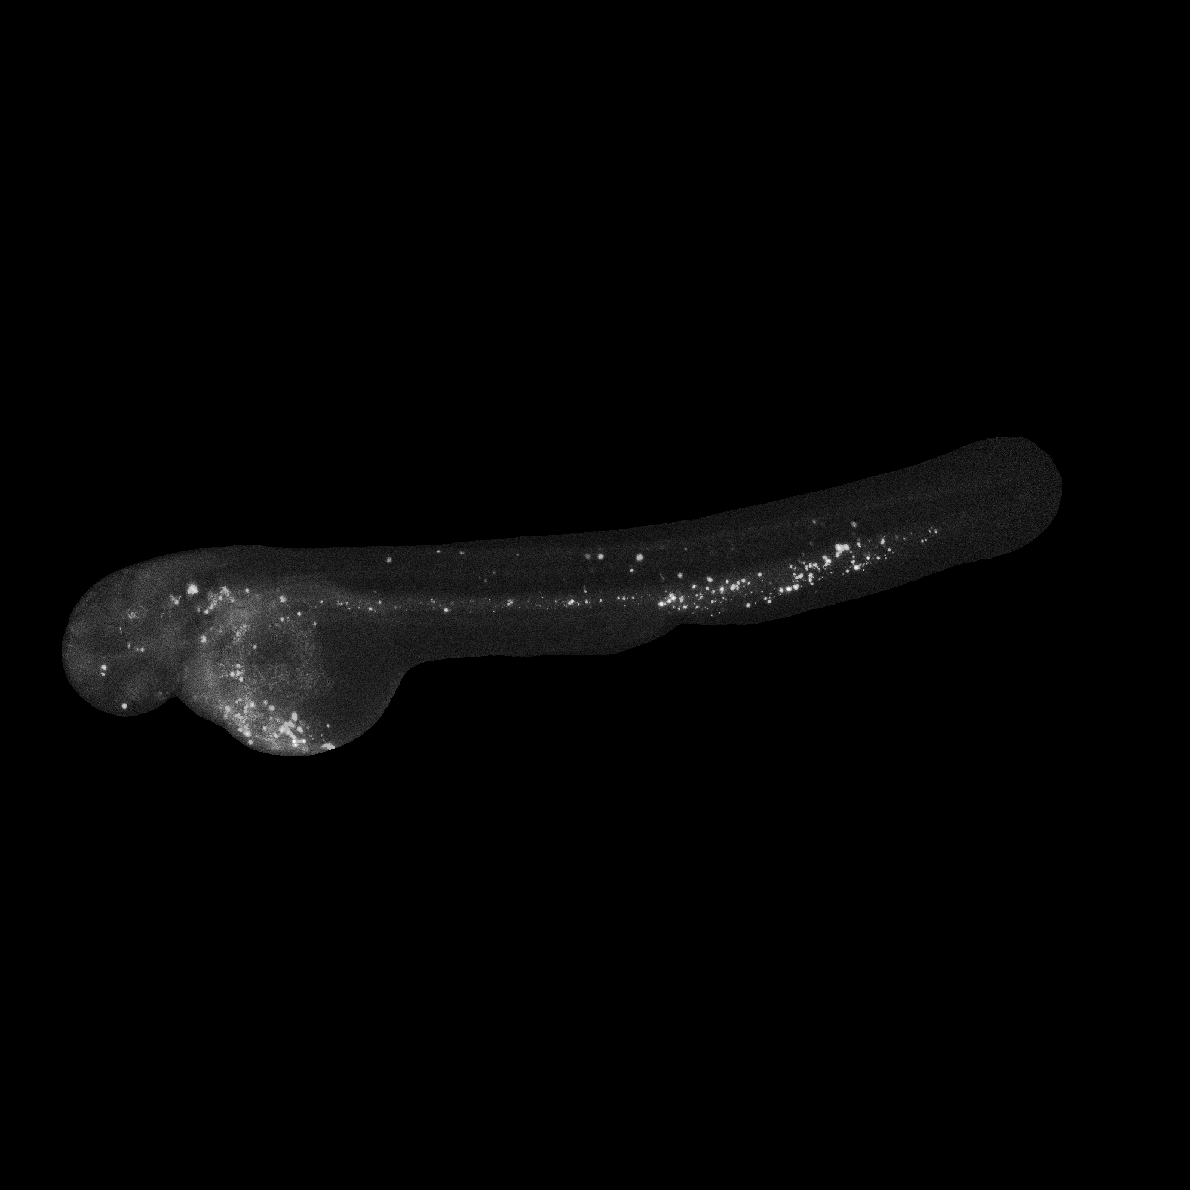
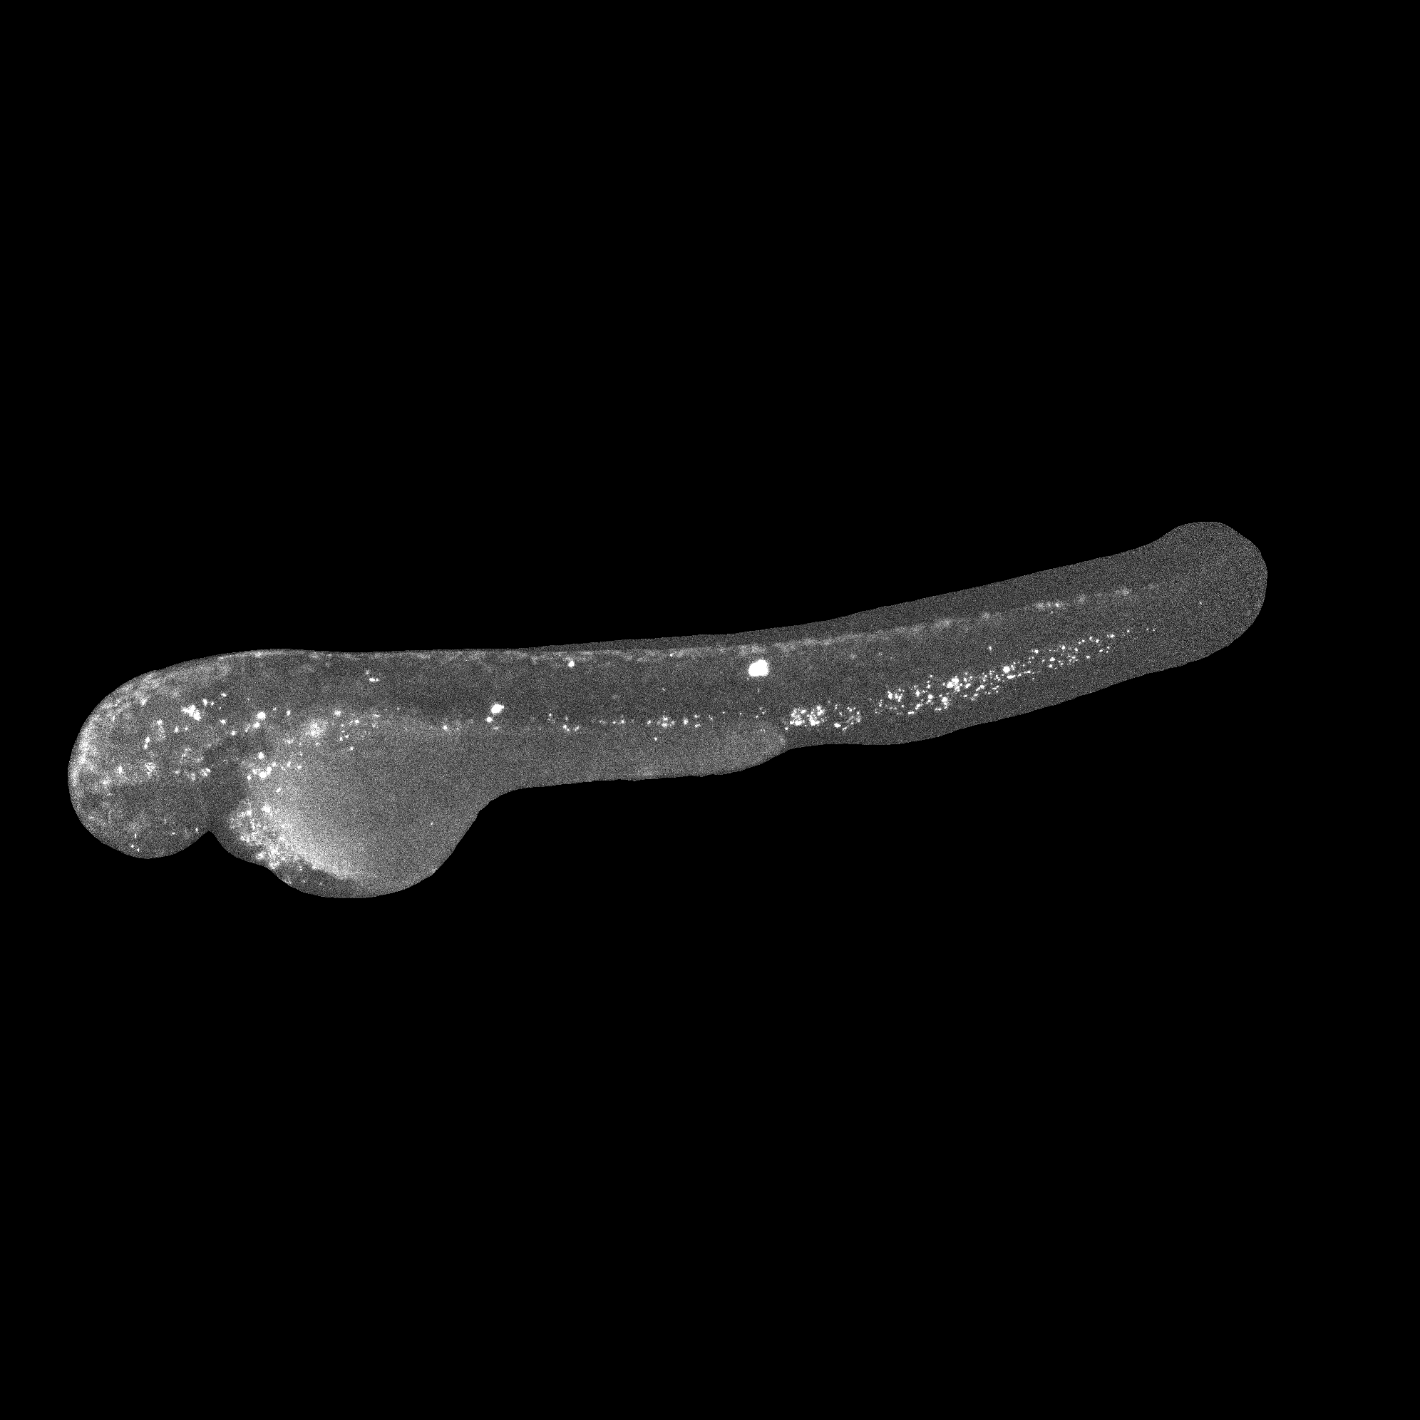
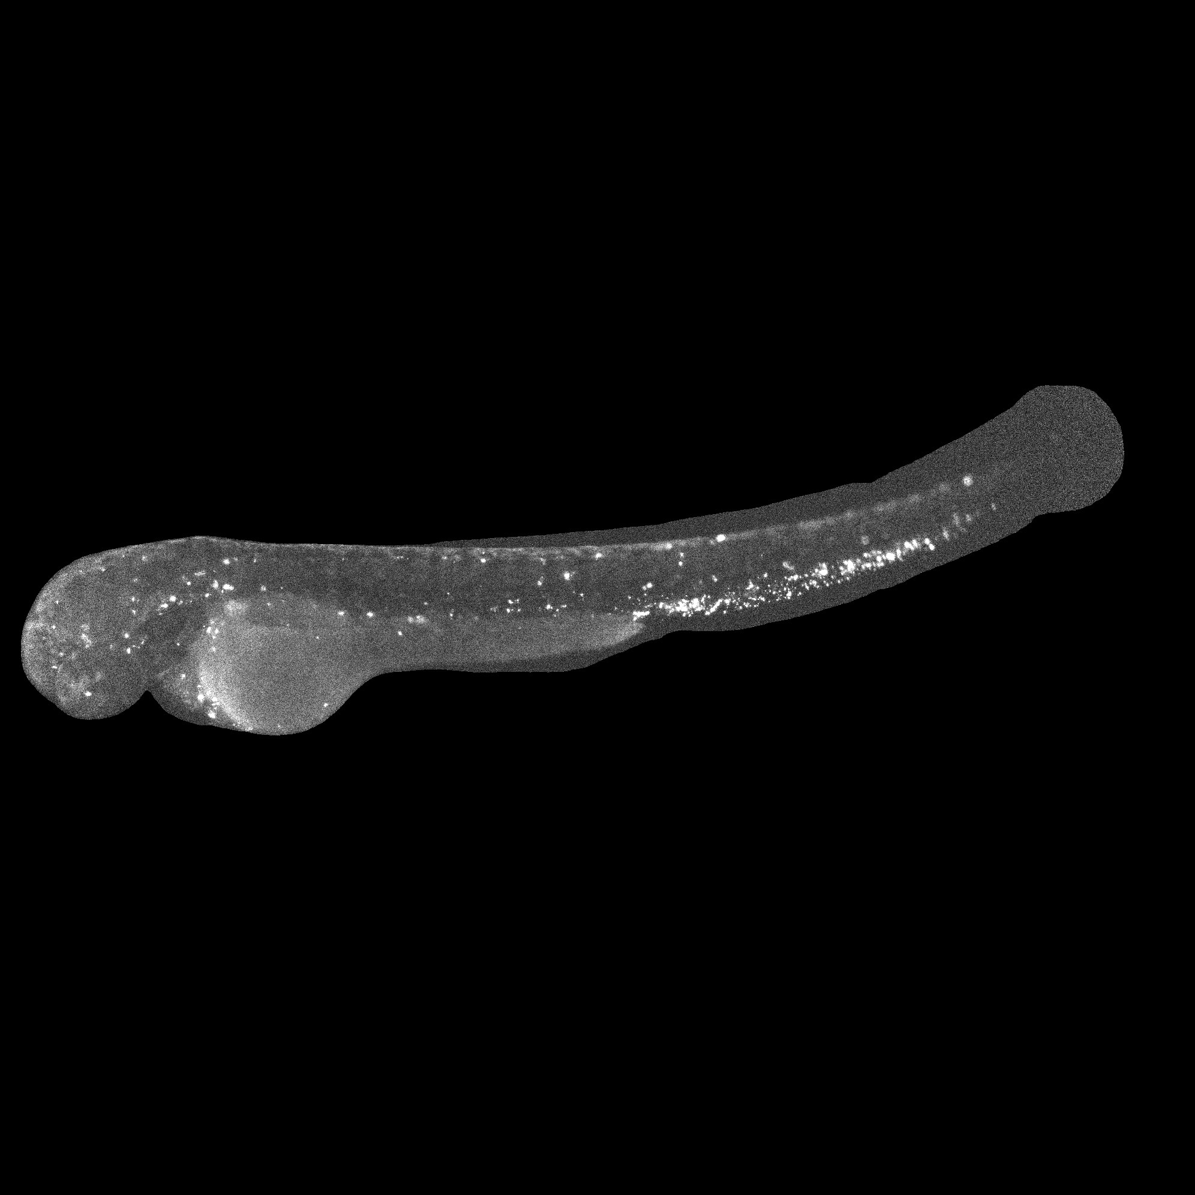
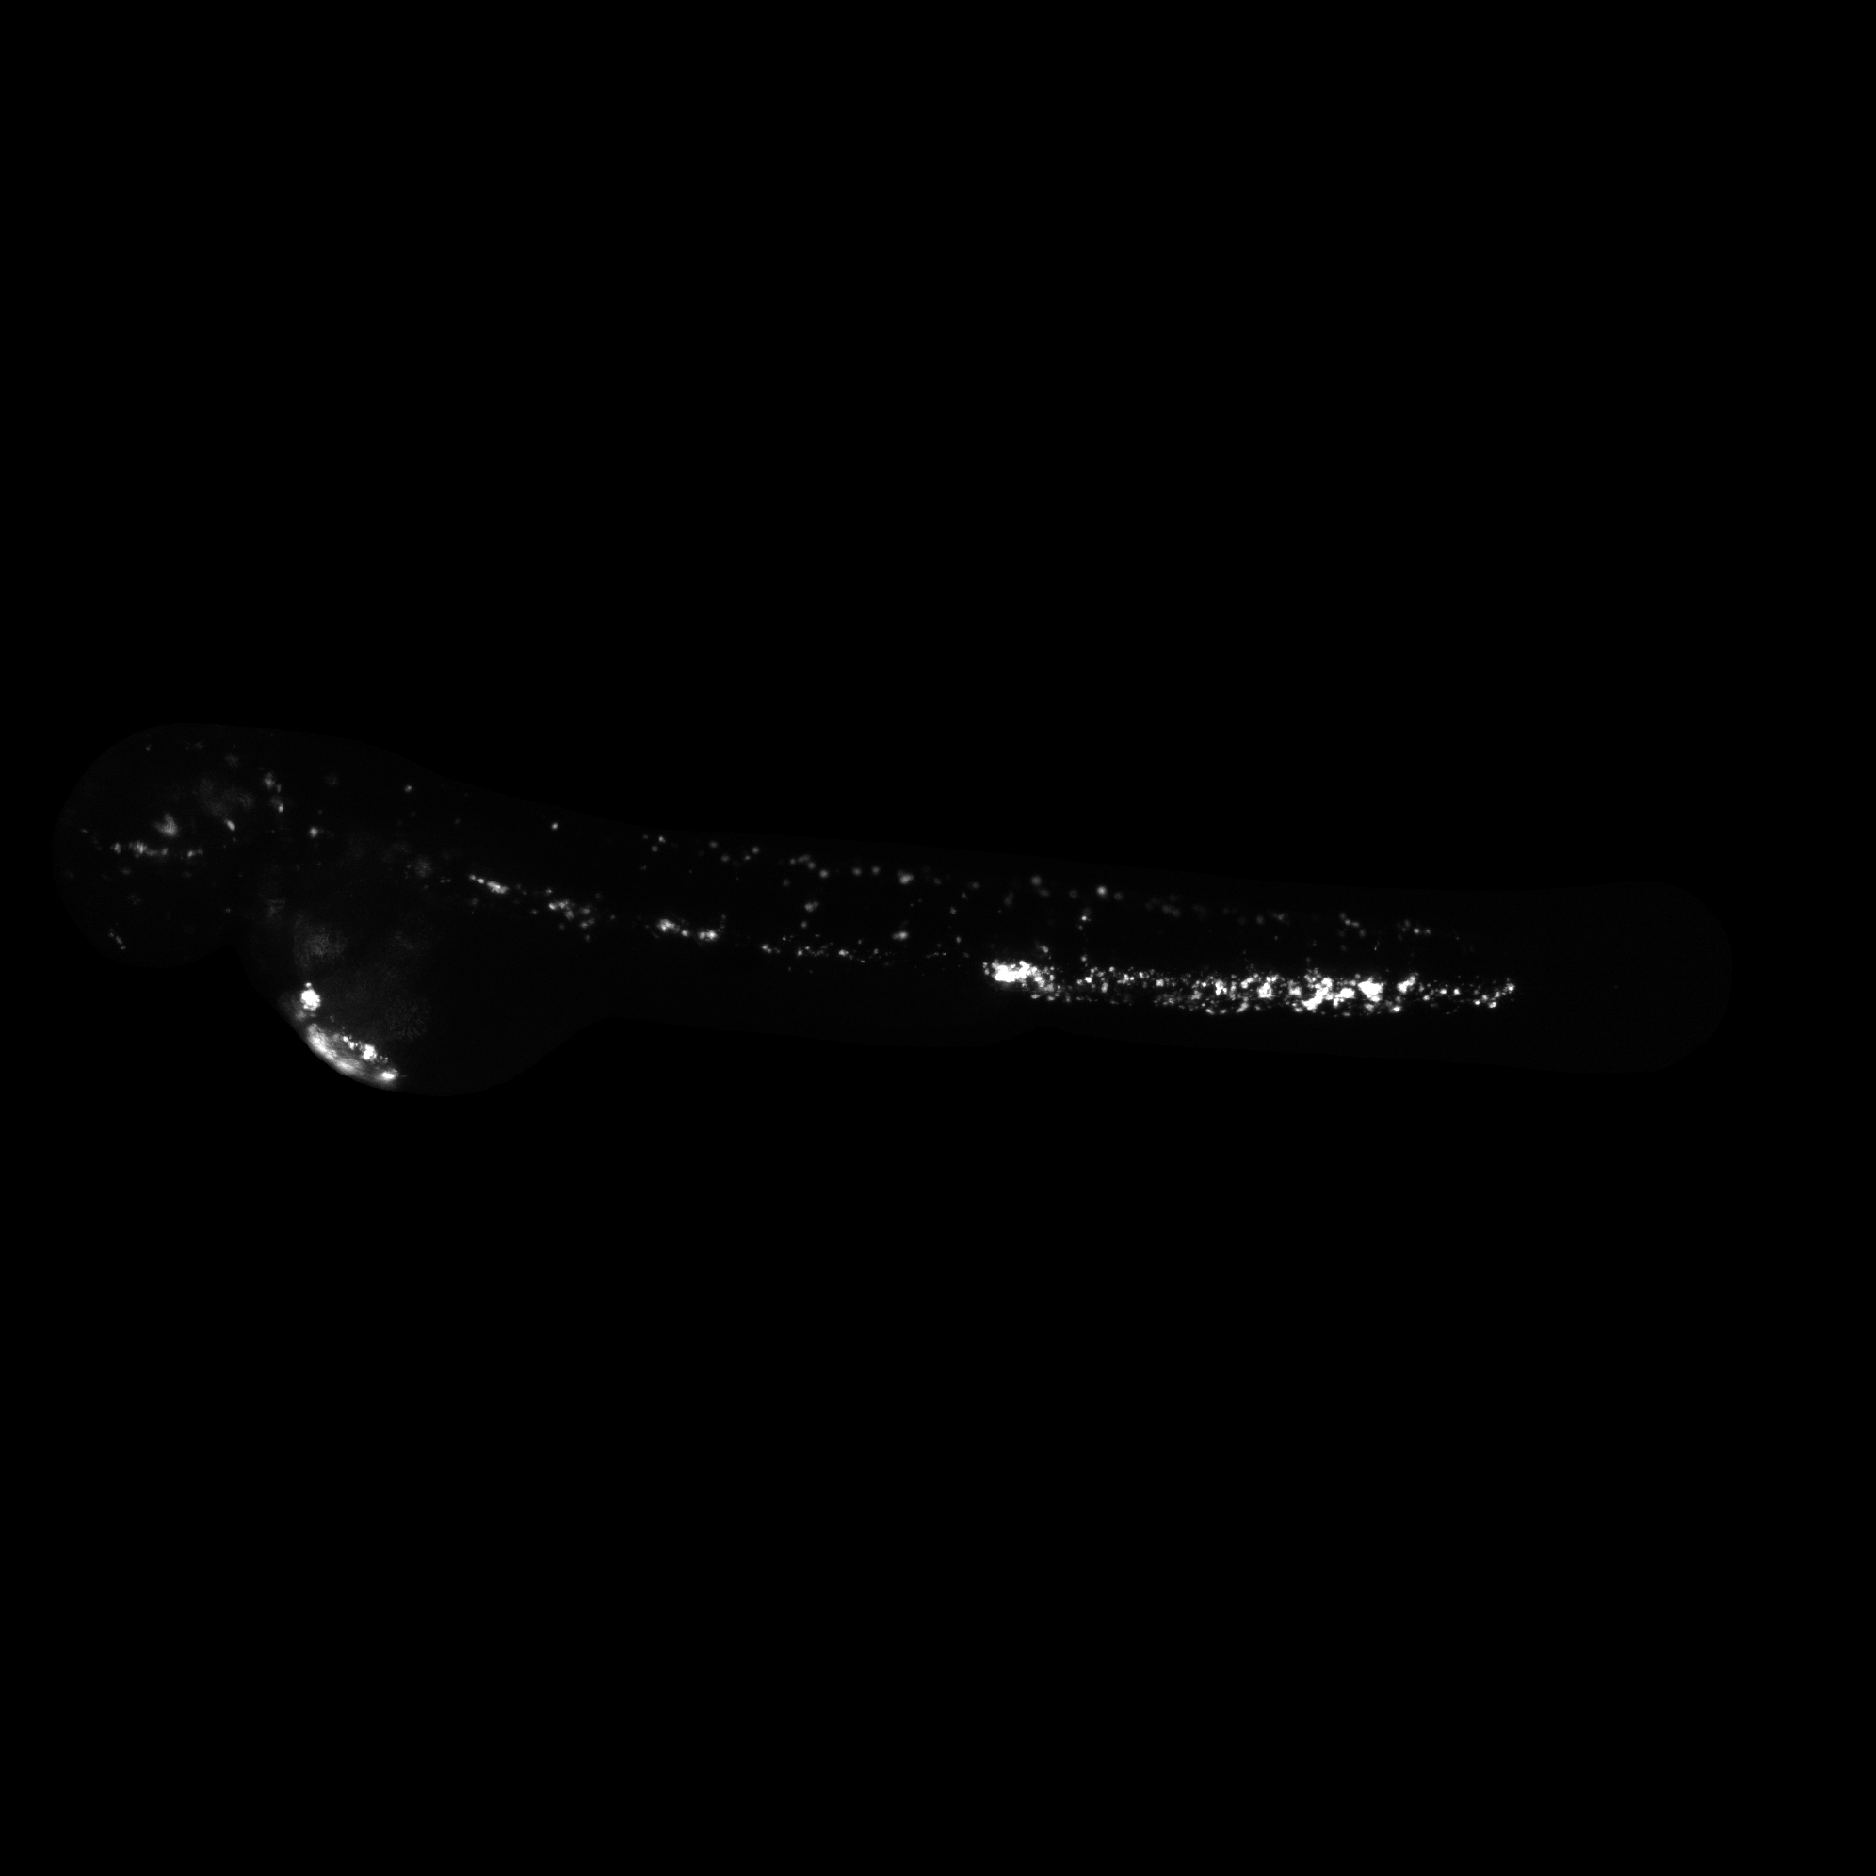
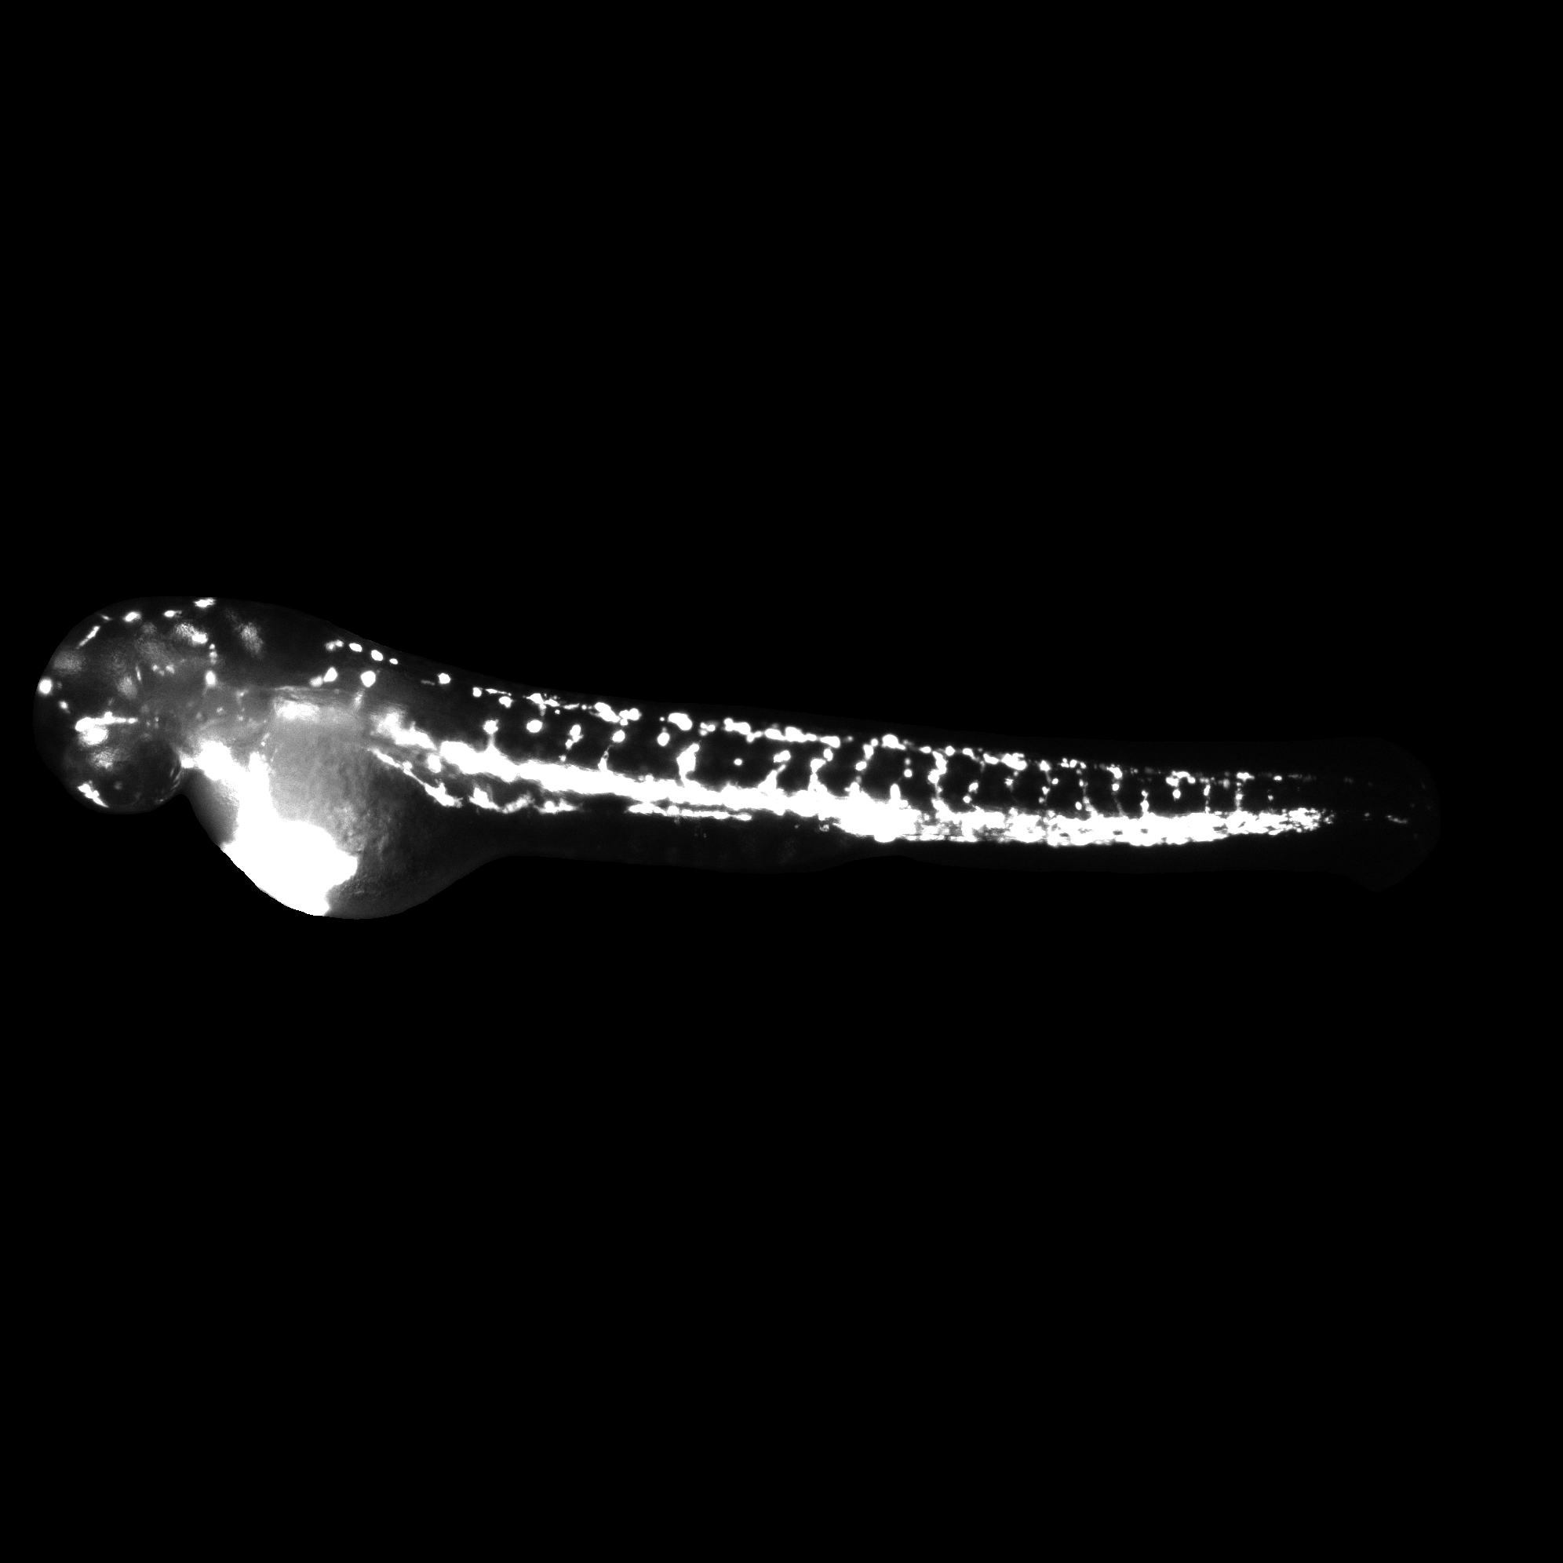
The groups
Group A: Treatment with MEndoB
Group B: Treatment with Vancomycin
Group C: Control PBS with infection
Group D: Blank ZF

Slide 5
The pipeline
Use phase contrast images to create masks
Split the segmented fish into head and tail
Apply masks on the GFP images
Extract GFP signal intensity
Mean and total GFP intensity for whole fish, head and tail
Subtract the background signal (Group D) for noise correction
Generate plots for comparison
Segment Anything Model (Meta)
Large model (vit-l)
Center point (predict())
8h run-time

Slide 6

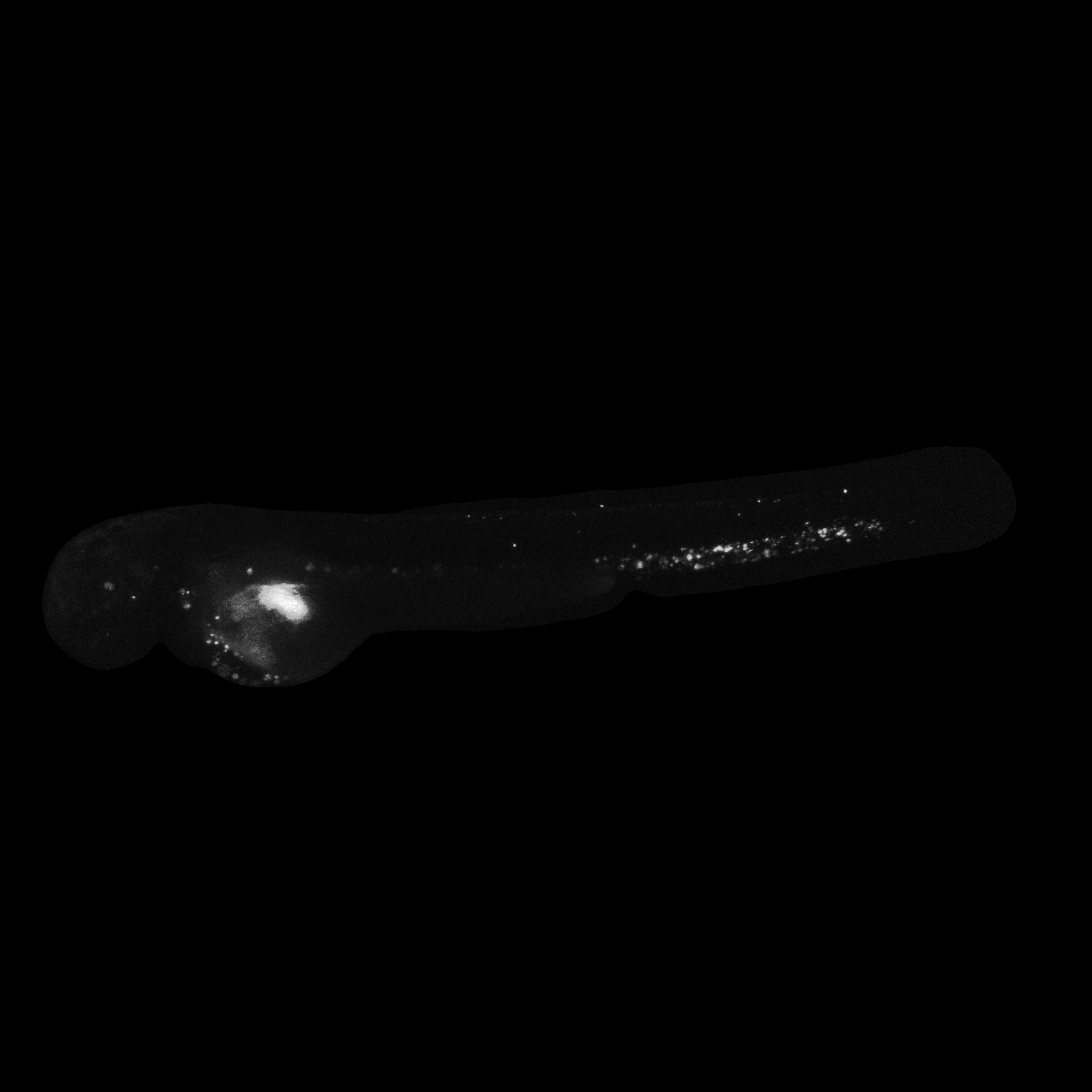


The masks

Slide 7
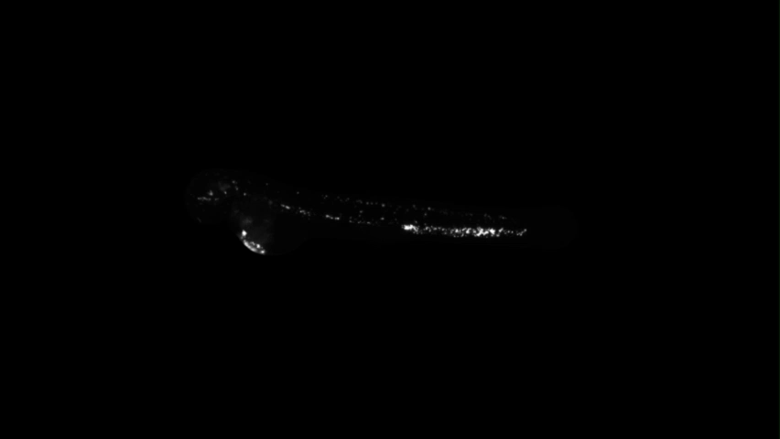

Slide 8
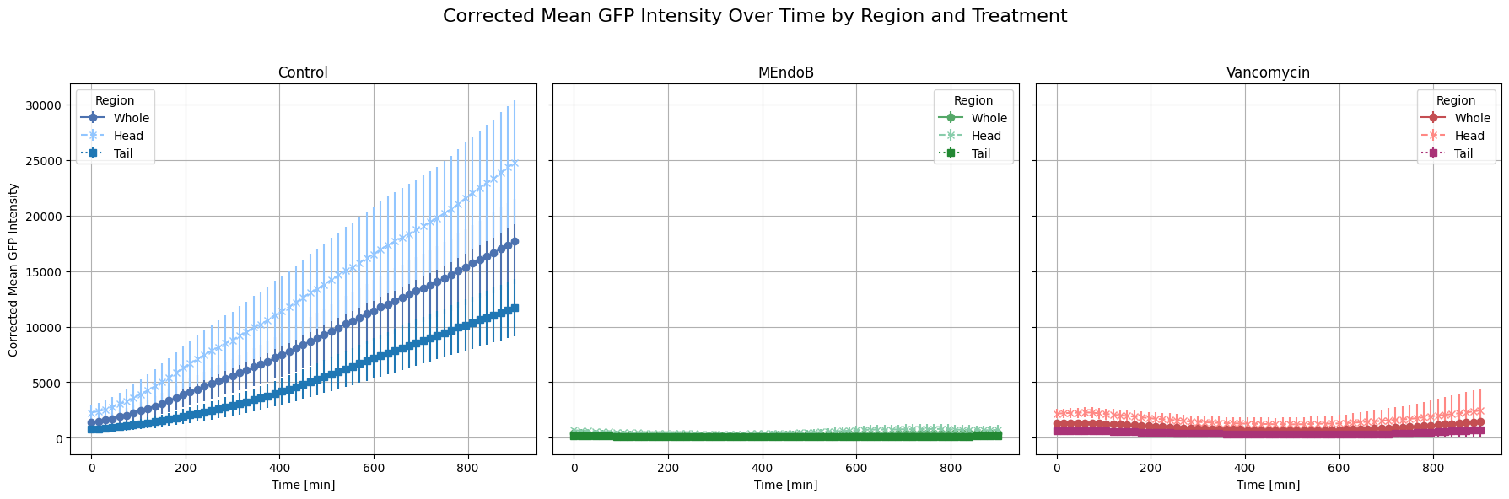
The outcome

Slide 9
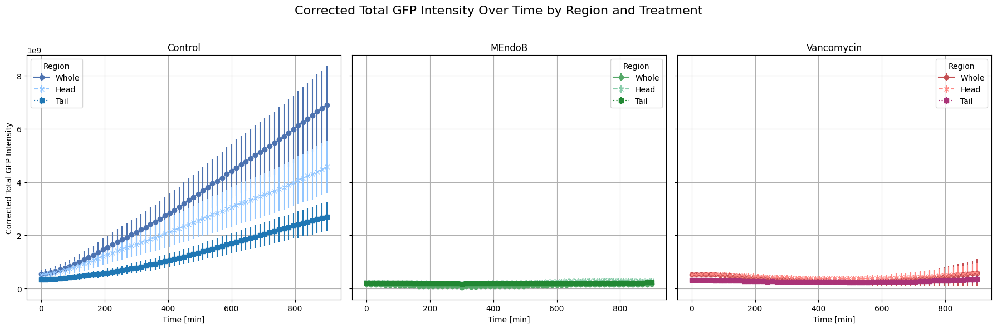

Slide 10
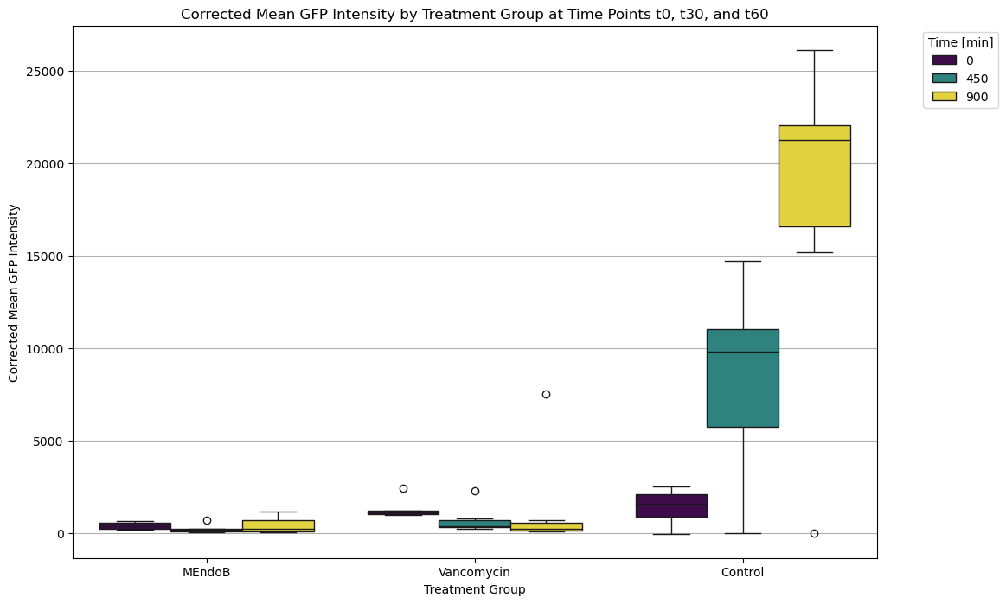

Slide 11
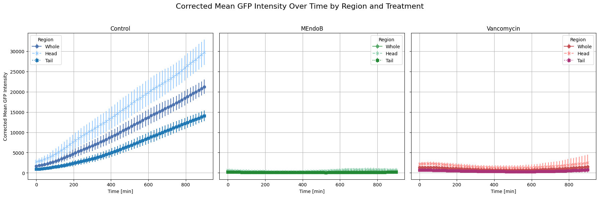
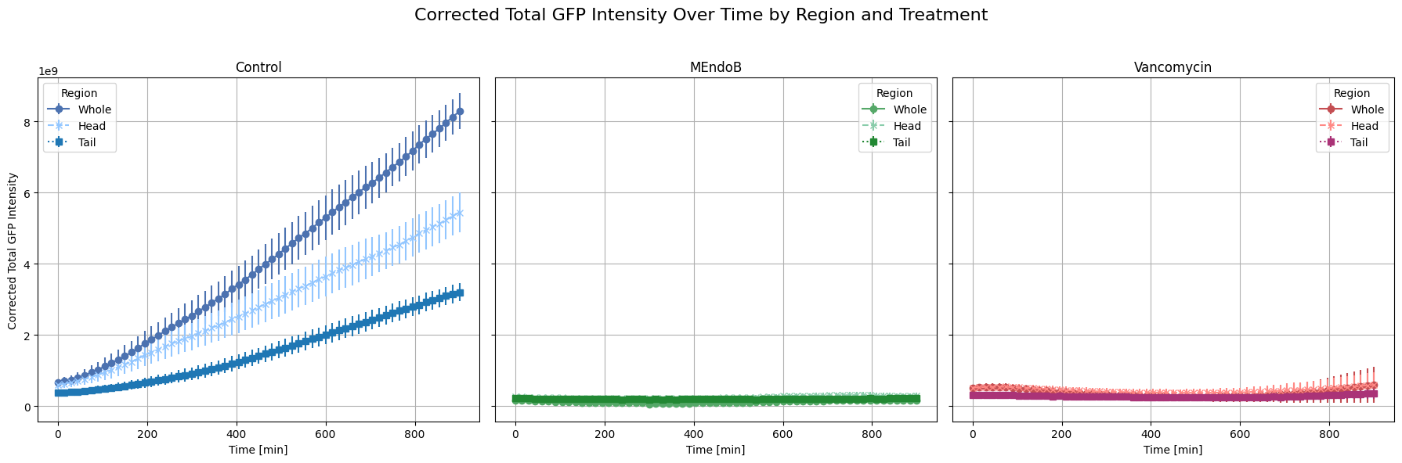

Slide 12
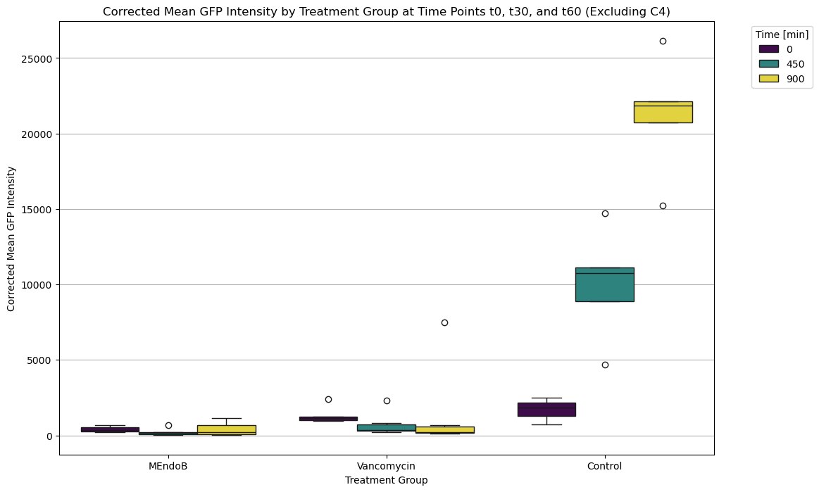

Slide 13
The future
Model takes a lot of processing time
Possible solutions:
Downsampling /-scaling of images in preprocessing
Capture images in lower resolution
Use a smaller Model of SAM (vit_b)
Short runtime but faulty mask generation
Improve algorithm to find head and tail region
E.g. start from head and move right until you find a minimum
Runtime!
Work with cluster / parallelization

